Slide 1
Misinformation on the Web
Presented by
Royal Pathak, Rohan Raut, Srabanti Guha, Deepti Gururaj Baragi
Service Learning to Address Teenagers’ Vulnerability to Web Misinformation

Slide 2
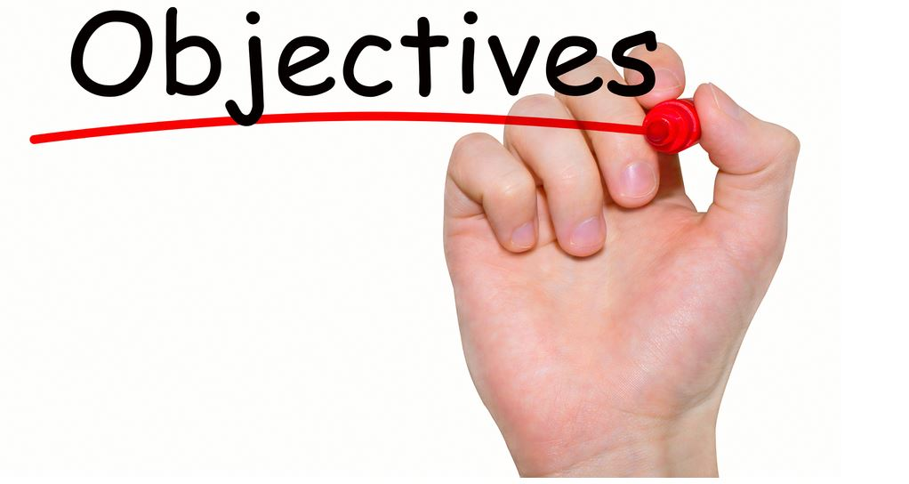
Understand the key differences between misinformation and disinformation
Fake news as opposed to other sample forms of misinformation
Why Fake news is dangerous ?
Characteristics of Fake news
Examples of truthful vs fake news
News Literacy and 5C’s
Present experiments and feature proposed result to detect fake news.
Notes:
Textual,Network,Propagation, and User characteristics
We computed readability, emotional and writing style features from the text and extracted 768 embeddings from the BERT layers. We used these all features along with supervised learning techniques such as Logistic Regression,SVC, Random Forest,Extra Trees, CatBoost, and XGBoost to detect fake news.

Slide 3
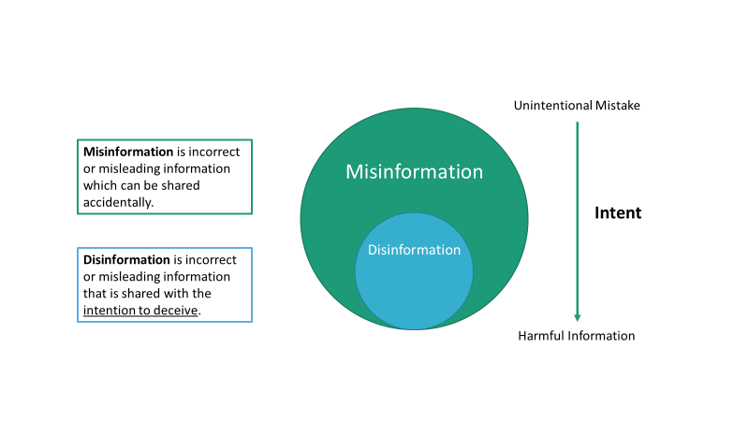
Misinformation vs. Disinformation
Notes:
Both Misinformation and Disinformation comes under the big umbrella of false information.
Misinformation are when the incorrect information is shared accidentally. However, there is the intention to deceive in disinformation.

Slide 4
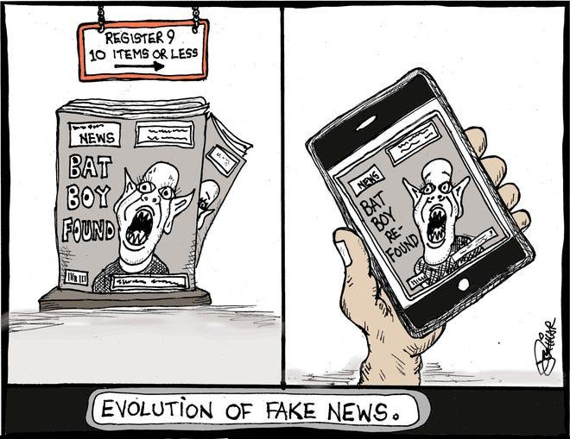
Fake News
Fake news is false or misleading information that is spread deliberately to deceive.
Notes:
Looking at the fake news, Fake news is misleading information that is spread deliberately to deceive people and cause harm.

Slide 5
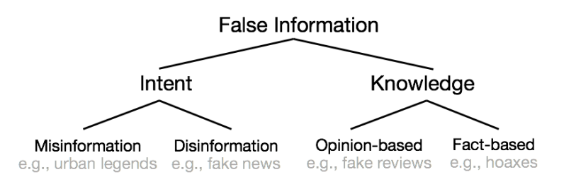
Other Forms of False Information
Source: Kumar, Srijan & Shah, Neil. (2018). False Information on Web and Social Media: A Survey.
Notes:
There are different type of false information. Taking intent into consideration we have misinformation and disinformation. Similarly, looking knowledge in consideration, we have opinion based and fact based.

Slide 6
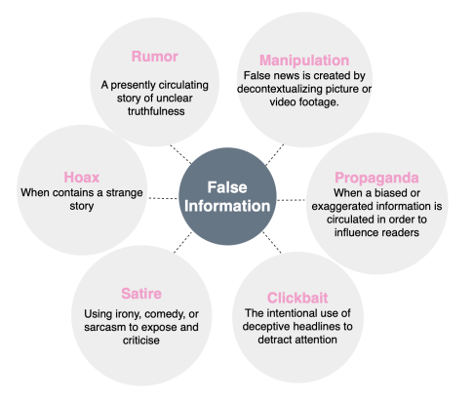
Other Forms of False Information
Source: Stitini, O.; Kaloun, S.; Bencharef, O. Towards the Detection of Fake News on Social Networks Contributing to the Improvement of Trust and Transparency in Recommendation Systems: Trends and Challenges. Information 2022, 13, 128. https://doi.org/10.3390/info13030128

Slide 7
Why misinformation is dangerous ?
Source/Spread
False claims from social media, podcasts, and misperceptions of scientific findings.
The Web 2.0 technology has further accelerated the consumption of fake news and its impact on society.
Case: The middle schoolers at Philadelphia believed that the earth is flat because of the idea they picked up from basketball star Kyrie Irving, who said that on a podcast[1].
[1] A Wolfman-Arent. The ongoing battle between science teachers and fake news. National Public Radio (NPR): Morning Edition, 2017.
Notes:
There are various source of misinformation in today's age of science and technology. Online sources like social media, podcast, wrong scientific findings. Web 2 technology has accelerated the consumption of fake news and its impact on society.
For example: there was a case where middle schoolers at philadelphia believed that earth is flat because of idea they picked from basketball superstar who said in the podcast. So we can see the influence of Web2 technology being a source to spread misinformation.

Slide 8
Why misinformation is dangerous ?
Construction/Context of information sometimes cost lives
Important and changes the meaning to Information.
Case: Donald J Trump made 11 tweets about unproven therapies and mentioned these therapies 65 times in White House briefings, especially touting hydroxychloroquine and chloroquine.
Tweets had an impression reach of 300% above Donald J Trump’s average.
Result: Death attributed to the wrongful ingestion of a chloroquine-containing compound occurred.
Source: https://www.ncbi.nlm.nih.gov/pmc/articles/PMC7685699/
Notes:
The construction and context of information are very important in news domain and changes to construction or context changes the meaning to the information.

Slide 9
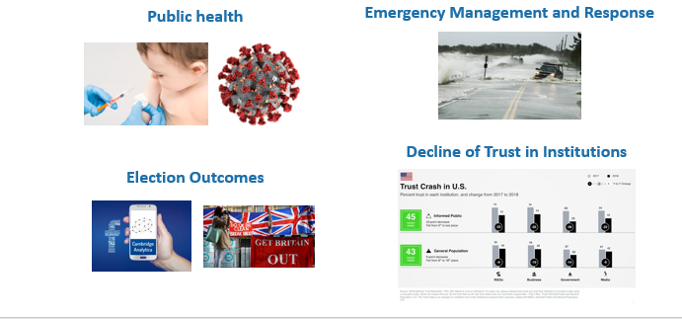
Why misinformation is dangerous ?
Real World Impacts
Notes:
Misinformation in social network have impacted various areas:
Public Health : We are aware with the fact that misinformation about COVID-19 possible treatments have tweeted by former president.Tweets had an impression reach of 300% above average. This misinformation have resulted to some deaths attributed to the wrongful ingestion of hydroxychloroquine and unproven therapies.
Likewise, we have seen misinformation impacting during emergency management and response, Election outcomes, and thus decline of trust in institutions especially news media who reports the news.

Slide 10
Characteristics of fake news
Textual Characteristics:
Incoherent headline and content body in the news articles,
For example, by using declarative headlines paired with bodies which are skeptical about the veracity of the information.
Attractive and Emphasized headlines
Network Characteristics:
Lower Clustering Coefficient & Fewer references
For example:hoax information has fewer references and significantly lower clustering coefficient compared to non-hoax articles
Accounts with significant overlap between their followers and followees.
For example:some bot accounts that spread false information are close to each other and appear as groups in Twitter’s follower-followee network.
Source: Kumar, Srijan & Shah, Neil. (2018). False Information on Web and Social Media: A Survey.
Notes:
Characteristics of fake news includes:
Textual characteristics where we can see incoherent headline and body content
attractive and emphasized headline
less informative body content
Network characteristics includes lower clustering coefficient and few references. Similar fake news spreading user-user network is strongly connected.

Slide 11
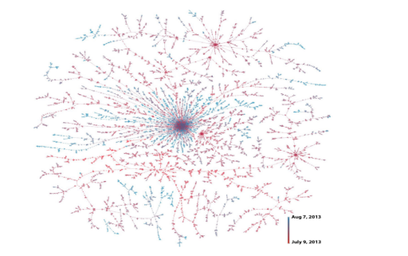
Characteristics of fake news
Propagation characteristics:
Spread by a small fraction of users
Spread across single or multiple platforms.
Repetition and perseverance play an important role in the spread.
Spread deeper compared to true news. False information reshare cascades spread much deeper compared to that of true reference cascades as shown in figure.
Spreads quickly during its early stage
Source: Kumar, Srijan & Shah, Neil. (2018). False Information on Web and Social Media: A Survey.

Slide 12
Characteristics of fake news
User characteristics:
More recently registered accounts
Less editing experience
Source: Kumar, Srijan & Shah, Neil. (2018). False Information on Web and Social Media: A Survey.

Slide 13
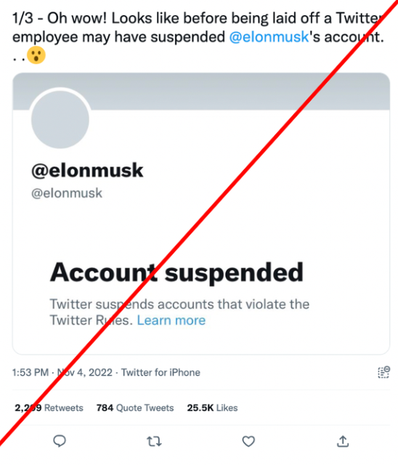
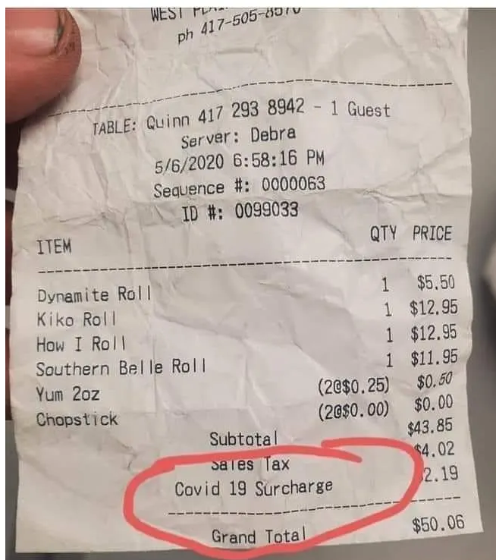
Example of truthful vs. fake news
"Does This Restaurant Receipt Show a COVID-19 Surcharge?"
Source: https://www.snopes.com/fact-check/elon-musk-account-suspended/ ,
Notes:
I have a game for the audience.
Here is the news which has claimed that outgoing Twitter employee suspended Elon Musk’s account on their way out. What do you think about this news ?

Slide 14

Example of truthful vs. fake news
"An outgoing Twitter employee suspended Elon Musk’s account on their way out."
Textual Characteristics
The linked suspended account uses an uppercase i instead of an l, making it look as if Musk's account was suspended.
Source: https://www.snopes.com/fact-check/elon-musk-account-suspended/
Notes:
This is a fake news because we can see the textual characteristics where linked suspended account uses an uppercase i instead of an l, making it look as if Musk's account was suspended.

Slide 15


"Does This Restaurant Receipt Show a COVID-19 Surcharge?"
Origination : Kiko Japanese Steakhouse & Sushi Lounge in West Plains, Missouri.
Further authentication : Report from KYTV television station, Springfield, Missouri
Admit in Facebook post:
Notes:
We can clear receipt of this news which can be reported by the local television like KYTV and similarly admitted by restaurant themselves.

Slide 16
News Literacy
News literacy helps to recognize the standards of fact based journalism to know what to trust and share.
Knowledge: Personal and social processes by which news are produced, distributed, and consumed.
Skills: Ability to think critically about the validity of information, which allows users to control over their knowledge and experience of news consumption.
More important as fake news are prevalent in online media and most people are incredibly news illiterate, digital nativity notwithstanding.
Knowledge +Skills
References: Tully, Melissa, Adam Maksl, Seth Ashley, Emily K. Vraga, and Stephanie Craft. "Defining and
conceptualizing news literacy." Journalism 23, no. 8 (2022): 1589-1606.

Slide 17
News Literacy
Context
The 5 C’s of News Literacy
Creation
Content
Circulation
Consumption
References: Tully, Melissa, Adam Maksl, Seth Ashley, Emily K. Vraga, and Stephanie Craft. "Defining and
conceptualizing news literacy." Journalism 23, no. 8 (2022): 1589-1606.

Slide 18
Context
The Social, Legal, and Economical environment in which news is produced.
Economical
Strongest influence on the how news production is shaped.
Can be turn into profits by news organizations.
Advertising, technology, public reactions,etc
Legal
Should follow terms of service for social media sites.
Governments influences on authors work.
Legal constraints such as libel laws, and first amendment.
Social
Make use of influences to monetize the effort of content producers.
Users should have the knowledge on political and economic context of the media.
References: Tully, Melissa, Adam Maksl, Seth Ashley, Emily K. Vraga, and Stephanie Craft. "Defining and
conceptualizing news literacy." Journalism 23, no. 8 (2022): 1589-1606.

Slide 19
Context
Section 230 - Communication Decency Act
Section 230 says that "No provider or user of an interactive computer service shall be treated as the publisher or speaker of any information provided by another information content provider".
Introduces and increases misinformation in social network.
Introductions of labels for fact checking by social media(Twitter).
References: https://www.eff.org/issues/cda230

Slide 20
Creation
The process of engaging in conceiving, reporting and creating news.
Creators - traditional journalists, citizen journalists, bloggers, influencers, aggregators, machine generated news from algorithms
Influencing factors
Backgrounds of news creators
demographic characteristics, educational attainment and socioeconomic status
Professional values
guided by norms such as objective behavior showcasing the dominant perspective and decision-making ability
Work routines
determine the newsworthiness using standard elements and present the news to capture audience’s attention

Slide 21
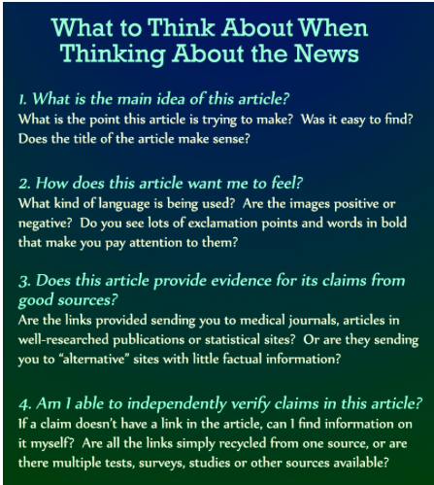
Creation
Quality Journalism
Multiple credible sources
Verification
Avoidance of Bias
Balance
Documentation
Context
Fairness
References: https://library.geneseo.edu/c.php?g=644162&p=4512925

Slide 22
Content
Content is the subject and claims of the article.
Textual Bias:
Fake news content is generally short in length and easy to read for people, it includes:
Repetitive words, small amounts of quotes and analytics words.
Buzz and emotional words.
Visual Bias:
Fabricated, photoshopped and emotional images. Fake articles contain images with people’s facial expression (anger, disgust, fear etc) and also may contain blurred or lower quality images due to the manipulation.
Source Bias:
If the sources are biased then they are more likely to publish more misleading information to support their preferences.
References: https://link.springer.com/chapter/10.1007/978-3-030-72240-1_9, https://link.springer.com/chapter/10.1007/978-3-030-61841-4_18

Slide 23
Circulation
Circulation is the distribution process of spreading fake news among people. Fake news circulation may happen both intentionally and unintentionally.
Intentional circulation : Usages bunch of fake accounts, bots and sockpuppets aiming at creating false impression, supporting each other’s false claim to confuse people.
Unintentional circulation: People’s lack of judgement, confused by attractive content, headline and their own bias contribute to the circulation of fake news.Rise and popularity of social media platform accelerate the circulation speed of fake news.
Recommender algorithm: The recommender algorithm ensures more personalized content to users, which can lead to the Filter Bubble effect /Echo-chamber effect.
Echo-chamber effect: People are frequently exposed to content that agrees with their belief. So, people may receive fake content many times from different channels and can even make it “go viral” also.
References: https://arxiv.org/abs/1804.08559, https://dl.acm.org/doi/10.1145/3395046

Slide 24
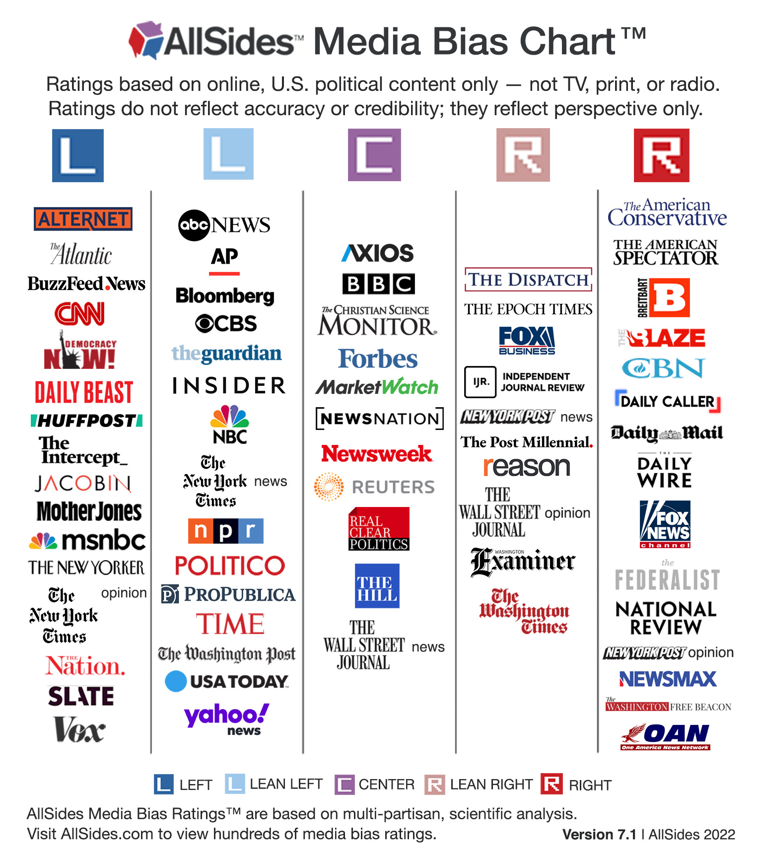
Consumption
Personal factors that contribute to news exposure attention, and evaluation and recognition of the effects of such consumptions.
Rely on recommendation algorithms to filter out view
Selective exposure - that matches view
Political Alignment
Confirmation Bias: Confirms previously existing beliefs or biases
Cognitive Bias: Unconscious error in thinking that arises from the way people perceive the world
Choice-supportive bias: Tendency to defend our own decisions now or in future
Primacy Effect: Individual's tendency to better remember the first piece of information they encounter
In-group Bias: tendency for people to give preferential treatment to others in same group
Validity Effect: Increase in perceived validity of repeated statements
Backfire Effect: Opposing beliefs bolsters the original stance
Source: A systematic review on fake news research through the lens of news creation and consumption: Research efforts, challenges, and future directions
Source: AllSides
Notes:
Confirmation Bias : Favoring information that confirms previously existing beliefs or biases.
The validity effect is the increase in perceived validity of repeated statements. In the first experiment, subjects rated repeated and nonrepeated statements for validity, familiarity, and source recognition.
The backfire effect is a cognitive bias that causes people who encounter evidence that challenges their beliefs to reject that evidence, and to strengthen their support of their original stance.
Cognitive bias is an unconscious error in thinking that arises from the way people perceive the world and the information around them that determines how they make decisions.
In-group Bias (also known as in-group favoritism) is the tendency for people to give preferential treatment to others who belong to the same group that they do.
Choice-supportive bias is our tendency to defend our own decisions or later perceive our choices as better than they are simply because we made them.
The primacy effect is a cognitive bias and refers to an individual's tendency to better remember the first piece of information they encounter than the information they receive later on.

Slide 25
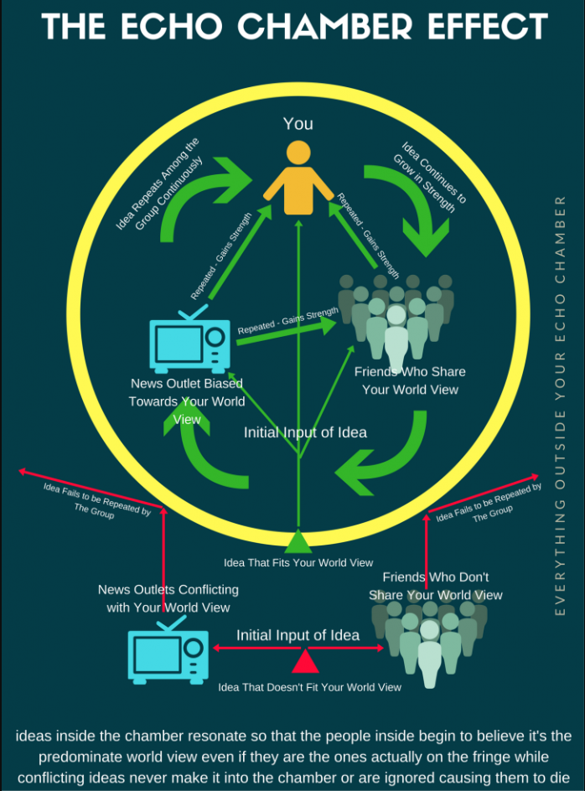
Bias interfere with news recommendation algorithms
Critics of search and recommender systems focus on cultural biases, including: gender, racial, sexual, age, religious, social, linguistic, geographic, political, educational, economic, and technological.
Personalization
Filter bubbles
Echo chambers for recommender systems
Echo chamber perpetuates misinformation.
Source: The destructive effects of echo chambers on society
Notes:
Personalization filter bubbles for users can create echo chambers for recommender systems
A filter bubble or ideological frame is a state of intellectual isolation that can result from personalized searches when a website algorithm selectively guesses what information a user would like to see based on information about the user, such as location, past click-behavior, and search history.
An echo chamber is "an environment where a person only encounters information or opinions that reflect and reinforce their own."

Slide 26
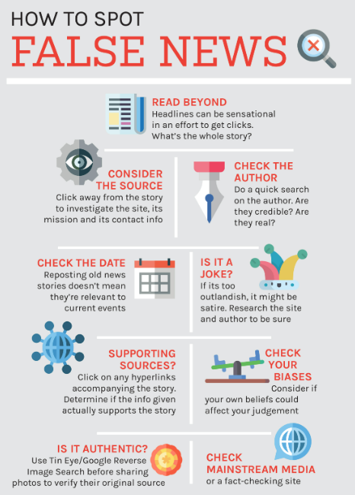
Tips on detecting fake news
Publisher and author’s reputation and authenticity
Verify the news outlet in the web
Refer to Fact Checkers
Assess Spelling, Grammar, and Punctuation
Investigate users sharing the news
Known bad actors in social media
People with history of sharing fake news might do it again
Supporting Sources : Check the hyperlink included
Use reverse image search option to find the original source of an image
Refer multiple sources
News article too outlandish or satirical
Check the date of the story (if it is an old story reposted )
Source : groundviews.org
Notes:
https://www.stopfake.org/en/how-to-spot-fake-news/
Are there other sites reporting similar narrative?

Slide 27
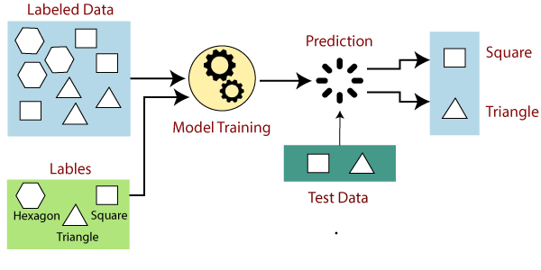
Experiment Setup
Dataset
We use recovery news-dataset containing news about Covid-19.
Procedure:
1. Feature Extraction
Readability Features
Writing style features
Emotion based features
2. Supervised machine learning model for classification.
References: Xinyi Zhou, Apurva Mulay, Emilio Ferrara, and Reza Zafarani. 2020b. Recovery: A multimodal repository for covid-19 news credibility research. In Proceedings of the 29th ACM International Conference on Information Knowledge Management, pages 3205–3212.
Source: Javatpoint
Notes:
The ReCOVery dataset was created to make studying and combating COVID-19 information easier. Following a search and investigation of almost 2,000 news outlets, 60 were found to have extremely high or low levels of credibility. A total of 2,029 news pieces about coronavirus, published from January to May 2020, are gathered in the archive, along with 140,820 ts that show how these news articles have spread on the Twitter social network, inheriting the authority of the medium on which they were published.
The news data includes the news id, the article's URL, the publisher, the publish date, the author's name, the article's title, the article's image, the article's body content, the political bias, the nation of the news source, and the ground truth. The article's reliability provides the ground truth, where 1 indicates reliability and 0 shows unreliable.
Suppose we have a dataset of different types of shapes which includes square, rectangle, triangle, and Polygon.
Now the first step is that we need to train the model for each shape. If the given shape has four sides, and all the sides are equal, then it will be labelled as a Square. If the given shape has three sides, then it will be labelled as a triangle. Now, after training, we test our model using the test set, and the task of the model is to identify the shape. The machine is already trained on all types of shapes, and when it finds a new shape, it classifies the shape on the bases of a number of sides, and predicts the output.

Slide 28
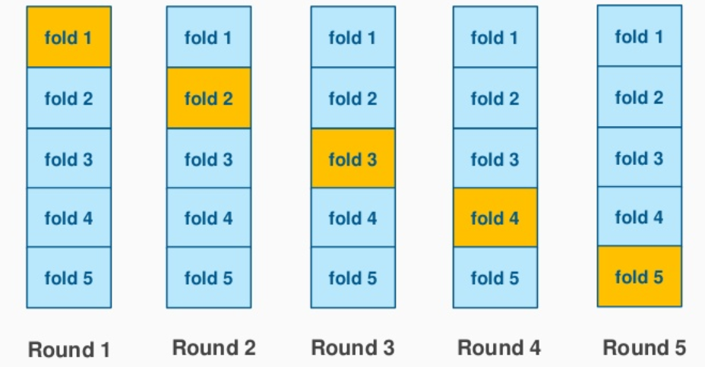
Some key points
There are 2029 instances with 46 features. In our work:
class_weight is used to deal with the data imbalance.
Stratified 5-fold cross validation is used to keep the target ratio constant in each fold.
Several supervised learning techniques are used to train classifier.
Source: Stackexchange
Notes:
Cross-validation is a statistical method used to estimate the skill of machine learning models.
Stratified: The splitting of data into folds may be governed by criteria such as ensuring that each fold has the same proportion of observations with a given categorical value, such as the class outcome value. This is called stratified cross-validation.
Splits the data into k folds, making sure each fold is an appropriate representative of the original data. (class distribution, mean, variance, etc)

Slide 29
Readability Features
Readability means the complexity of textual content. We have extracted 8 readability features.
1. Flesh Reading Ease
2. Flesh Kincaid Grade Level
3. Coleman Liau Index
4. Gunning Fog Index
5. Simple Measure of Gobbledygook Index (SMOG)
6. Automatic Readability Index (ARI)
7. Lycee International Xavier Index (LIX)
8. Dale-chall Score
Notes:
The Flesch scale ranges from 0 to 100. Higher Flesch reading-ease ratings suggest that the text is easier to read, while lower scores indicate that it is more difficult to read.
The Coleman Liau Index gauges the text’s readability based on the word’s characters.
The Gunning Fog Index, the Flesh Kincaid Grade Level, the SMOG Index, the Automatic Readability Index, and the Gunning Fog Grade Level are algorithmic heuristics used to determine readability based on the num- ber of educational years needed to comprehend the text. Lastly, the Dale-Chall reading test gauges the text’s difficulty using a vocabulary list that fourth- graders are familiar with. We use this group of eight readability features to measure the complex- ity of a user’s writing style.
The SMOG Index and the Automatic Readability Index are algorithmic heuristics used to determine readability based on the number of educational years needed to comprehend the text.
Lastly, the Dale-Chall reading test gauges the text’s difficulty using a vocabulary list that fourth- graders are familiar with. We use this group of eight readability features to measure the complexity of a user’s writing style.

Slide 30
Writing style Features
Writing styles features can determine if news is written by professional journalists or not.
We have computed average-
(1) number of characters per news item
(2) percentage of stopwords
(3) part of speech
Besides that, we have measured number of nouns, proper nouns, personal nouns, possessive nouns, pronouns, determinants, adverbs, interjections, verbs, and adjectives.
Notes:
This set of features captures the writing style of the tweets.
Specifically, we computed the average number of words, the average number of uppercased words, the the average number of characters per user tweet, the percentage of stopwords, and the use of part of speech such as the number of nouns, proper nouns, personal nouns, possessive nouns, pronouns, determinants, adverbs, interjections, verbs, and adjectives.

Slide 31
Emotion Features
LanguageTool: Clean up news content.
NRC Word Emotion Association Lexicon: List of english words and their association with emotions.
We have catched 2 types of sentiments in our emotion features.
Positive:
Joy, Trust, Surprise, Anticipation, Happy, Reliability, Inspired, Objective, Amused.
Negative:
Anger, Disgust, Fear, Sadness, Afraid, don’t care, Sad, Annoyed, Angry.
References: Saif Mohammad. 2018. Word affect intensities. In Proceedings of the Eleventh International Conference on Language Resources and Evaluation (LREC 2018), Miyazaki, Japan. European Language Resources Association (ELRA). Ashlee Milton and Maria Soledad Pera. 2020. What snippets feel: Depression, search, and snippets.
Notes:
Fake news is purposely sparked by emotionally charged statements to sway public opinion and damage feelings of a particular group by inciting their anger, fear, and mistrust in the direction of the event, individual, and agency.
Thus, we calculated emotional traits such as anger, happiness, sadness, fear, disgust, anticipation, surprise, and trust.
We computed emotion features including anger, pleasure, disappointment, fear, disgust, anticipation, marvel, and trust. We used the Emotion Intensity Lexicon (NRC-EIL) and happy, unhappy, angry, do not care, inspired, afraid, amused.Firstly, we cleaned up the news content by expanding contraction phrases, using LanguageTool 6 to fix spelling and grammar errors, swapping out negated terms for their WordNet antonym, removing forestall phrases, and lemmatizing the words. We specifically looked up each word in the two emotion dictionaries and mapped the corresponding affect values of the words that matched. To create an emotion vector, we then normalized the ranks of each emotion class using the full range of emotions that were retrieved from a news text. If two lexicons had the same emotion, such as sad in NRC-EIL and unhappiness in Emolex, we took the average of the two computed values into consideration.

Slide 32
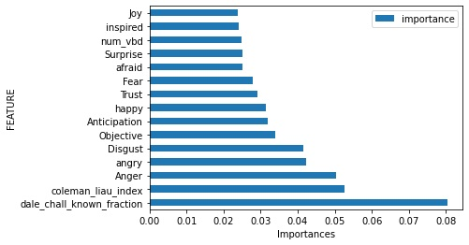
Feature Importance (Random Forest)

Slide 33
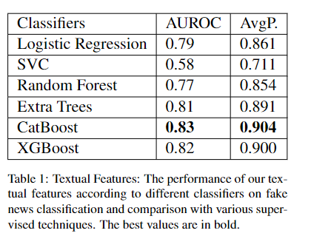
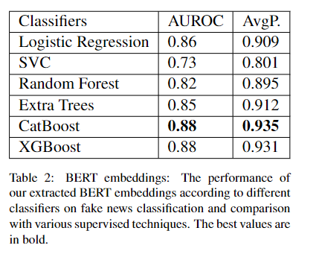
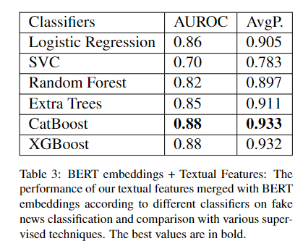
Result
Notes:
XGBoost is a popular and efficient open-source implementation of the gradient boosted trees algorithm. Gradient boosting is a supervised learning algorithm, which attempts to accurately predict a target variable by combining the estimates of a set of simpler, weaker models.

Slide 34
CatBOOST for different Textual features
Feature type | AUROC | Average precision
Readability Features | 0.719 | 0.822
Writing Features | 0.731 | 0.8335
Emotions Features | 0.772 | 0.867

Slide 35
Conclusion
Our experiment shows boosting algorithms perform well than other supervised algorithms.
Among textual features, emotional features are most useful for the detection of fake news.
Negative emotions were important to detect fake news.
We believe that extension of our work will include adding user features and network features.

Slide 36

THANK YOU!
Any Questions?
royalpathak@u.boisestate.edu
rohanraut@u.boisestate.edu
srabantiguha@u.boisestate.edu
deeptigururajbar@u.boisestate.edu

